Slide 1
AI Compiler: Basics and Optimizations

Slide 2
General Flow
AI-DSL Design
Optimization Passes

Slide 3
General Flow: Compilation Procedure
High-level representation lowering to hardware code gradually
  High-level framerwork：pyTorch，TensorFlow，...
  High-level DSL：Triton，Tilelang，...
  Low-level DSL：CUDA，Ascend C，...
  Intermediate Representations：MLIR（TIR，TGIR），LLVM，...
  Hardware Code：PTX，CPU ISA，NPU ISA，...
Introduce hardware information gradually and optimize automatically
  Computation graph optimziation, parameter sweeping, register assignment, ...
IR/DSL to meet the needs of AI comutation
  TVM: tensor operation
  Tilelang: tile-level abstract

Slide 4
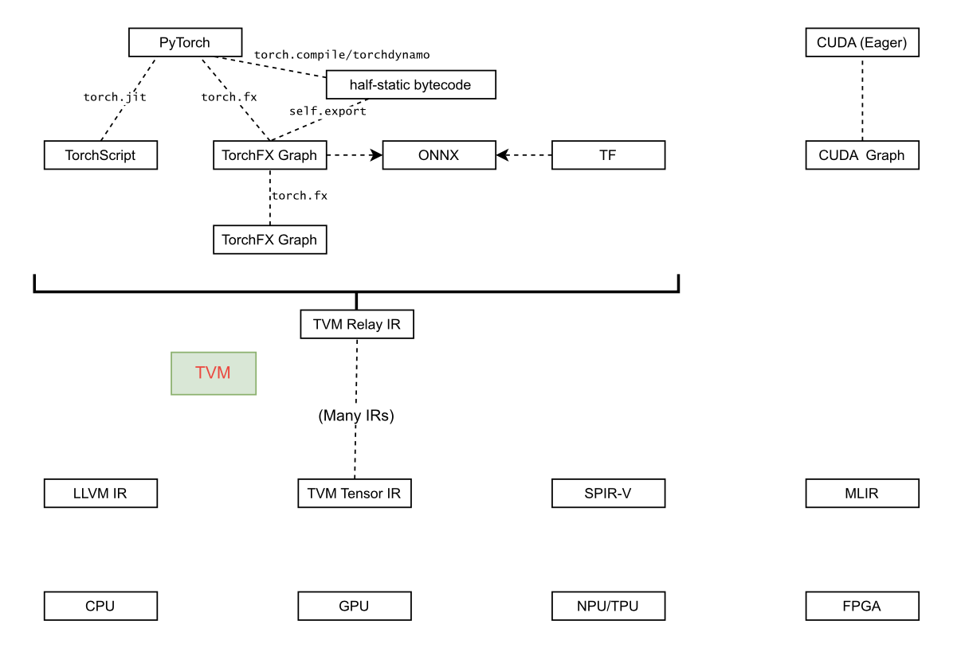
General Flow: Computation Graph
Computation graph：Design the dependency among opertors in AI-computing tasks
  Static graph（Tensorflow1.x）
    Specify at compilation, easy to optimize
  Dynamic graph（PyTorch）
    Specify at runtime, fit for modern LLM
Why computation graph
  Represent forward and backward relationship
  Fit for multi-level AI operator representation
Components
  Nodes：Tensor/Data or operation
  Edges：Opertaion or Tensor/Data

Slide 5
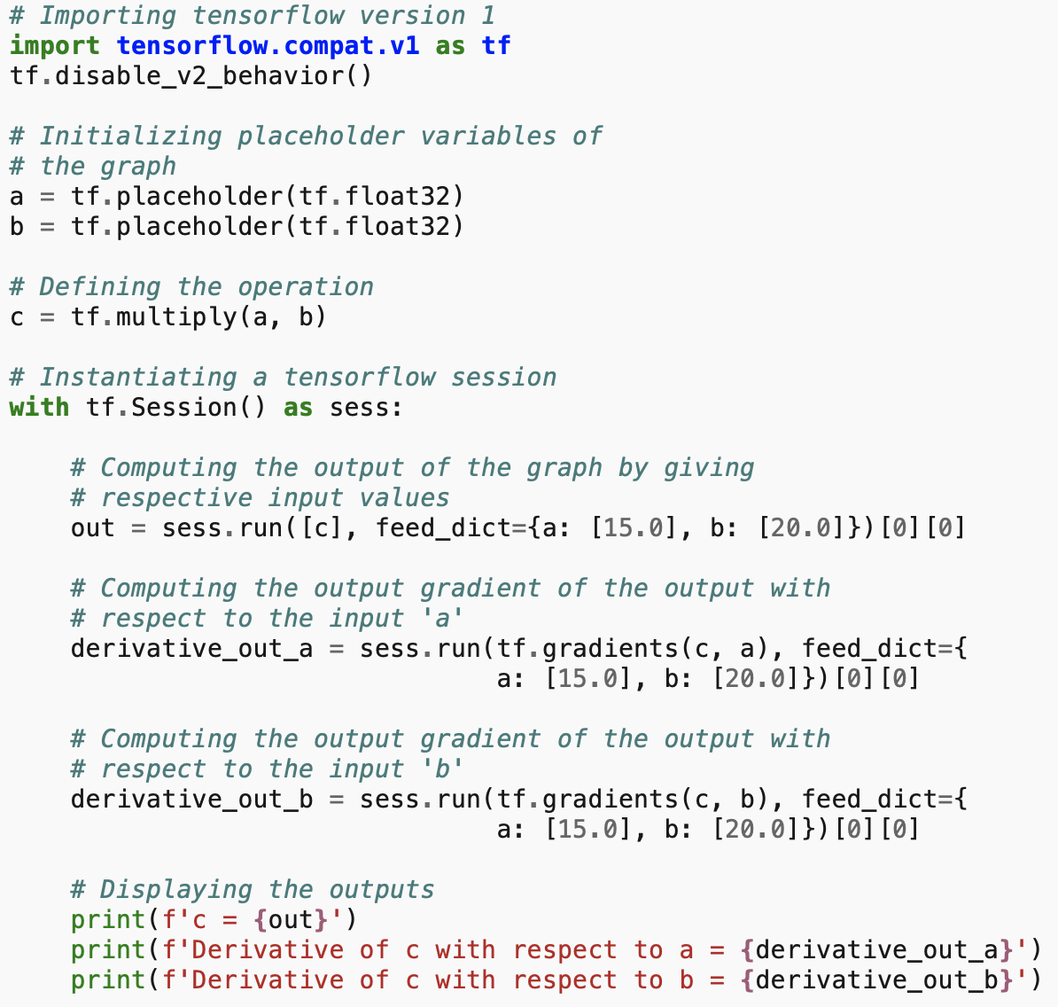
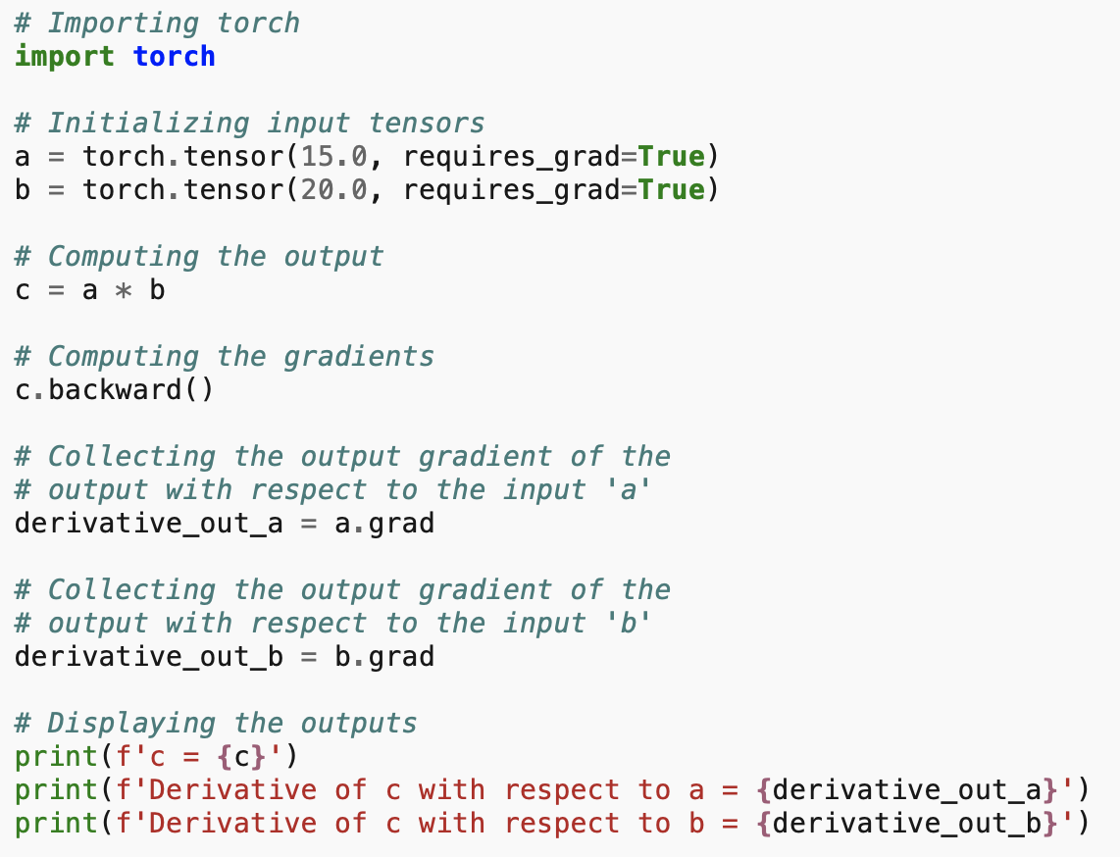
General Flow: Computation Graph
Computation graph construction
  Static：Define variable and operation before compilation->Obtain computation graph
  Dynamic
    Define variables
    Forward pass
    Construct on the fly
    Backward pass
Optimization time
  Static：compilation
  Dynamic：runtime
PyTorch Dynamic Graph
Tensorflow Static Graph

Slide 6
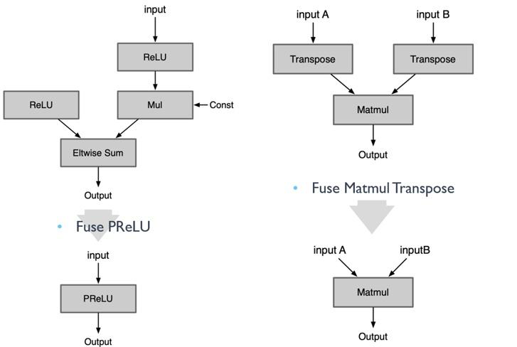
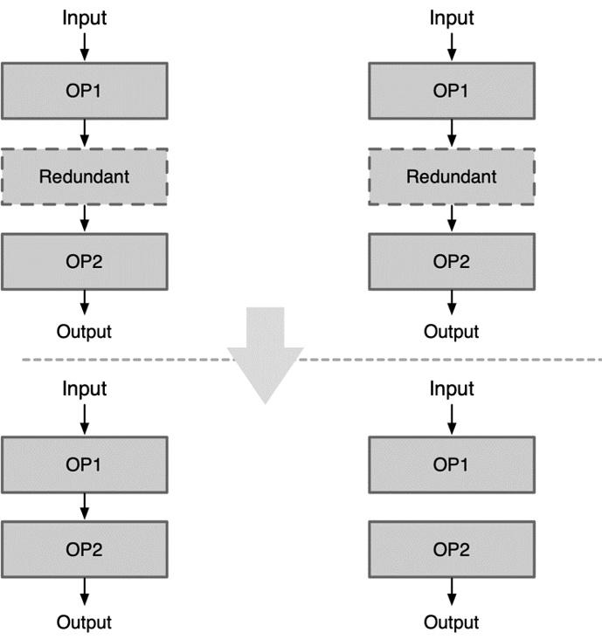
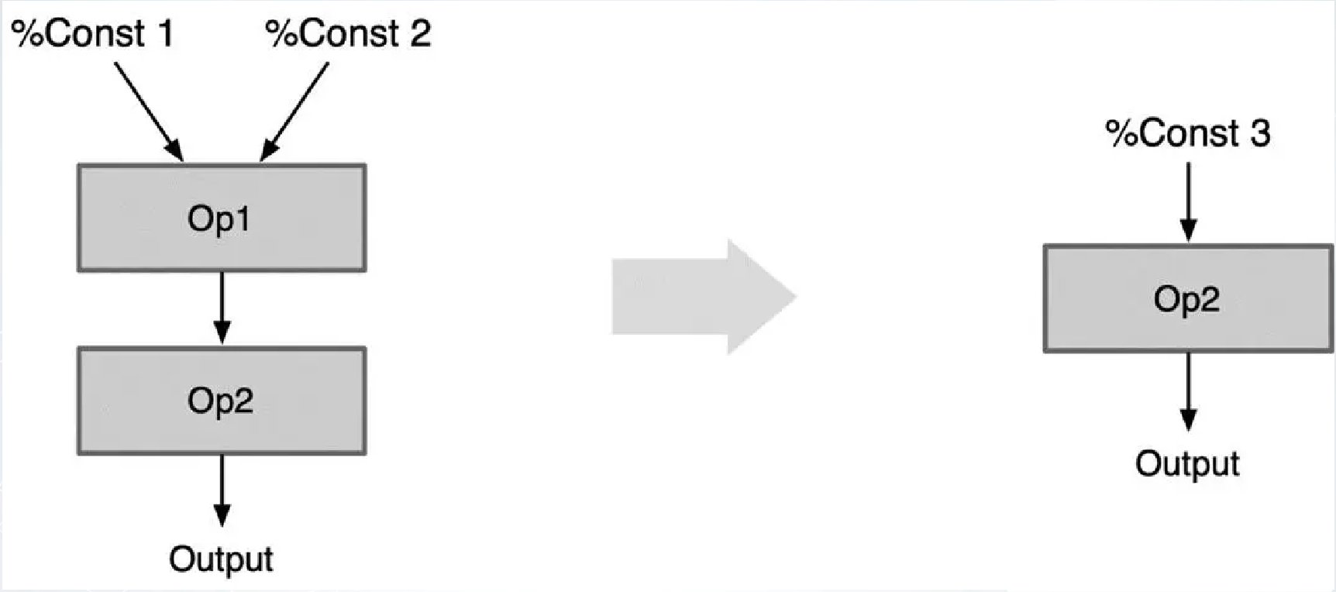
General Flow: Graph Optimization
Operation fusion
  Reduce data transimission
  Reduce launch overhead
  Simplify graph pattern
Redundant node elimination
  Certain operations are inactive
    cast between same data types
Constant folding
  Calculate in advance for constants

Slide 7
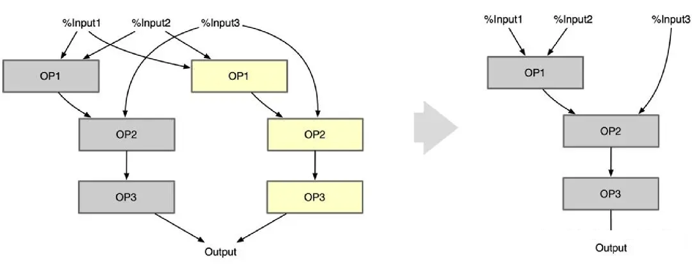
General Flow: Graph Optimization
Common subgraph optimization
  Common subgraph: same structure, parameter and input
  Reuse subgraph
Operator substitute
  Equivalent operator subsitution for certain hardware feature
    Conv can be calculated by TensorCore by adding some additional calculation
    Two consecutive conv can be subtitute by an equivalent conv

Slide 8
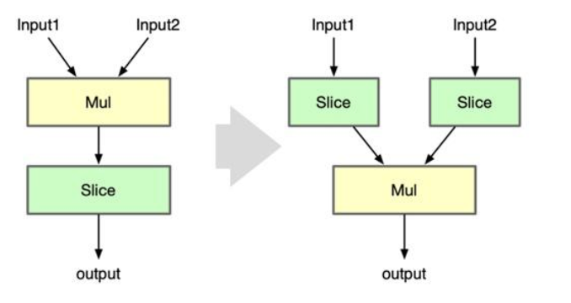
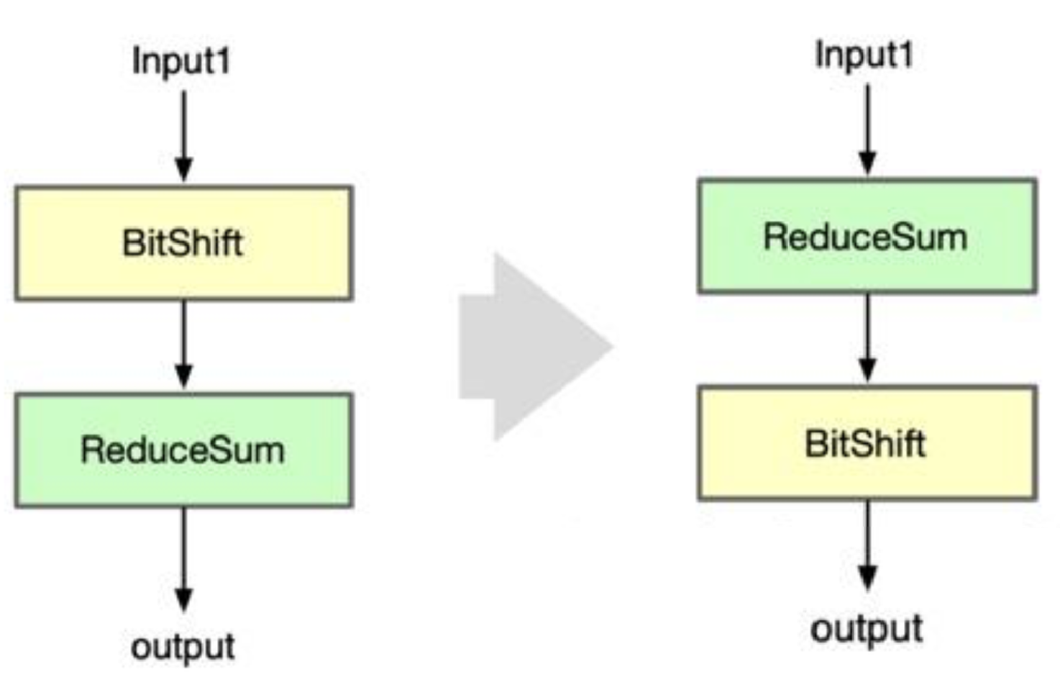
General Flow: Graph Optimization
Operation scheduling
  Caluculate some operation in advance to reduce duplicate computation
  Reduce data transfer cost

Slide 9
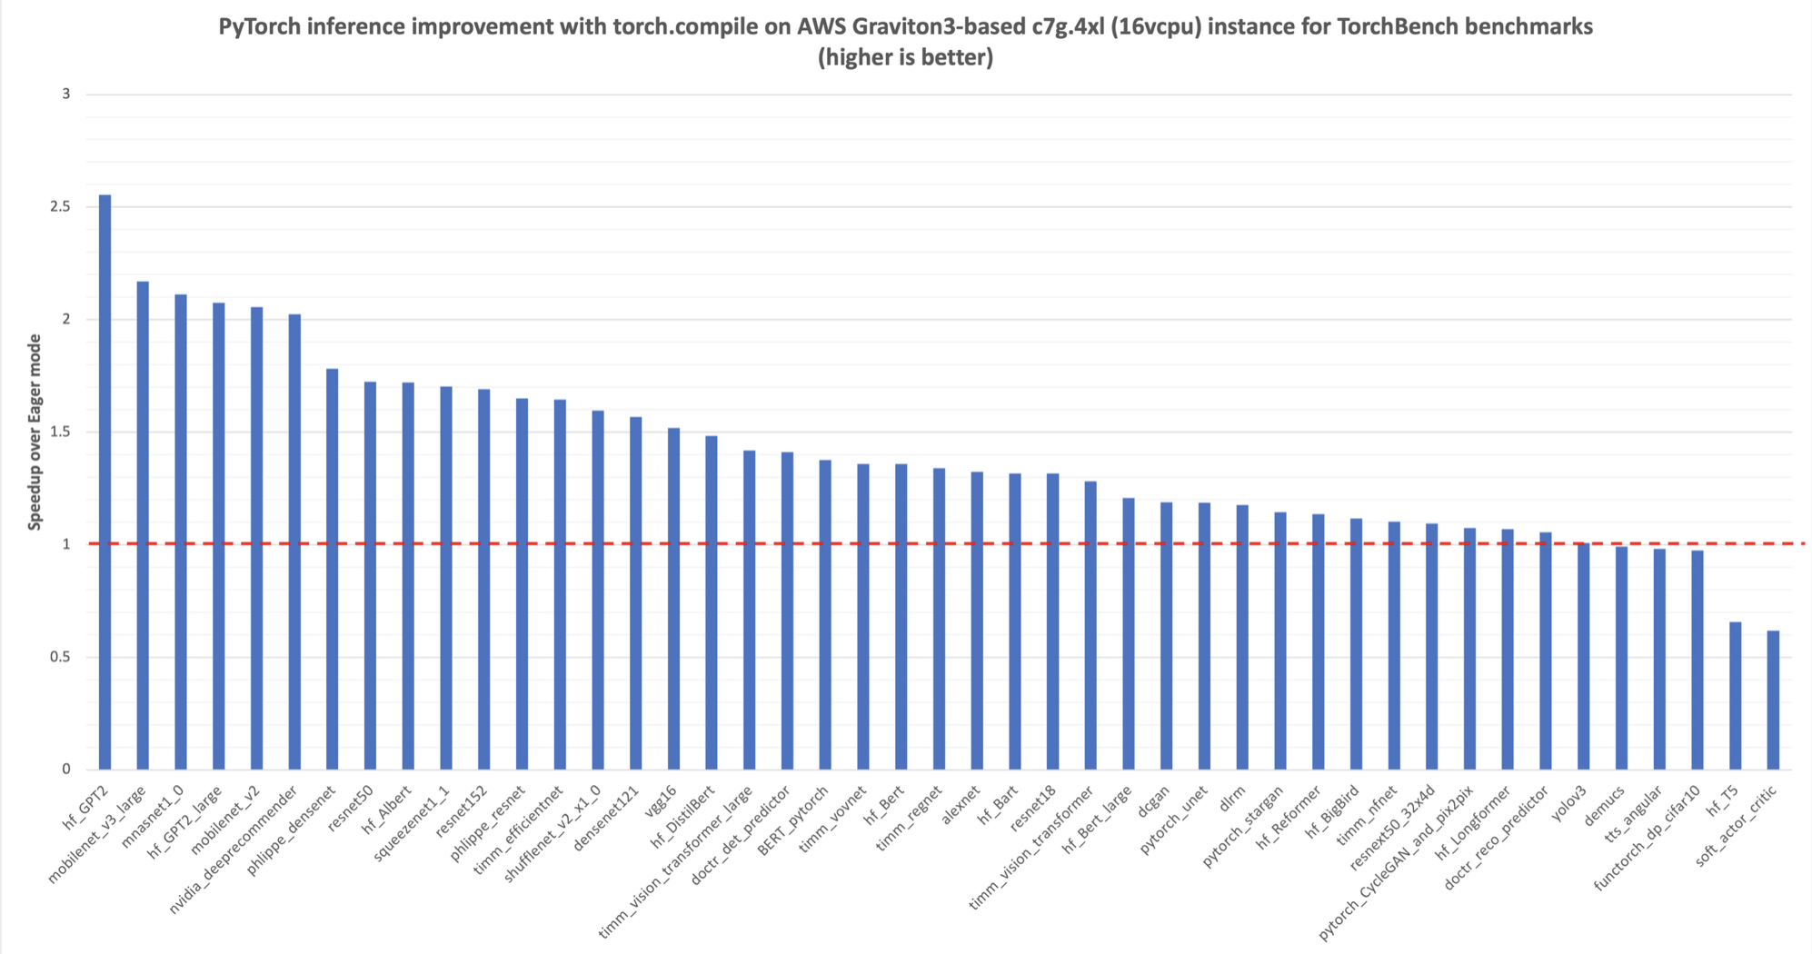
General Flow: torch.compile
Dymanic-Static Tradeoff
  Both PyTorch and TensorFlow extends thier computation graph (torch.fx and TensorFlow2.0)
  Easy to develop and efficiently optimized for execution
torch.compile: Benchmark and Optimization On-the-fly
  Main idea: Optimize current computation as long as it does not change
  Faster Compilation and faster execution after first run

Slide 10
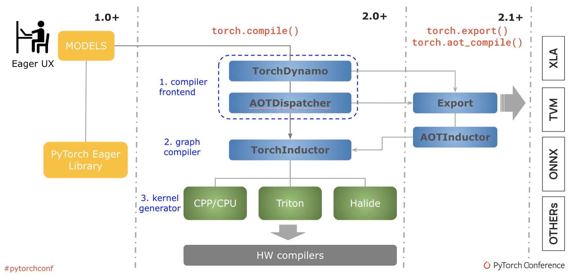
General Flow: torch.compile
TorchDynamo
  Rewrite python bytecode
  Retrieved computation graph from bytecode
  Output forward static graph in first run
AOTAutoGrad
  AOTDispatcher: dispatch operator to specific kernel
  AOT-ahead of time: trace BP graph simultaneously as forward computation graph
TorchInductor
  Optimize graph and generate hardware code
  Leverage kernal fusion and other methods for sepcific architecture

Slide 11
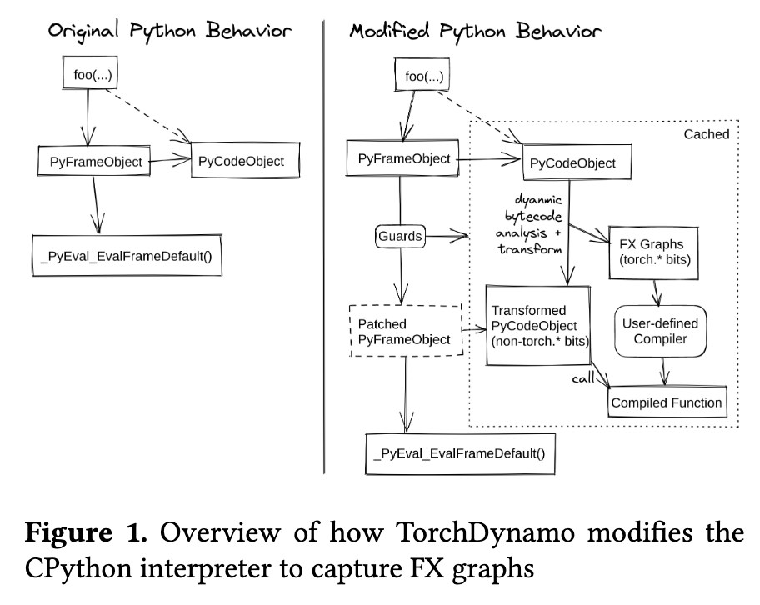
General Flow: TorchDynamo Overview
Eager Mode Pros and Cons:
  PyTorch define-by-run mechanism is highly flexible and well-loved by researchers . However, the framework can only see one operator at a time, making cross-operator graph-level optimization (e.g., operator fusion, memory scheduling) difficult.
Compromises of Previous Approaches:
  TorchScript: Attempts static parsing of Python AST, facing“all-or-nothing” dilemma, easily failing because it doesn't support complete Python semantics .
  Lazy Tensors: High runtime overhead, delaying low-level kernel launch and causing frequent recompilation .
TorchDynamo Core Motivation:
  As a Python -level Just-In-Time compiler, the goal is to achieve Python graph compilation without sacrificing any PyTorch flexibility .

Slide 12
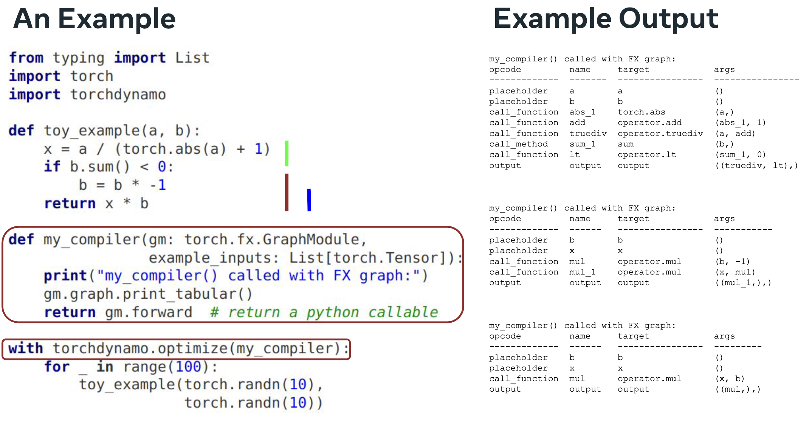
General Flow: TorchDynamo Example

Slide 13
General Flow：TorchInductor
Graph fusion: Combines multiple pointwise operators
  May generate equivalent Triton kernels on the fly
Scheduling: Determines loop ordering, tile sizes, and parallel execution
Backend Selection
  GPU→ Triton
  CPU→ C++/OpenMP
Memory planning: reduces temporary tensor allocation

Slide 14
General Flow
AI-DSL Design
Optimization Passes

Slide 15
AI-DSL Design: Why DSL?
Gap between AI computing abstract and GPU execution model
  Deep learning models are naturally expressed as tensor algebra
  GPUs execute massively parallel scalar instructions
Human/Agent workload
  Explicit thread/block management, Memory hierarchy (global, shared, registers), Synchronization primitives, Instruction scheduling, Architecture-specific optimizations, ...
DSLs separate algorithm description from performance implementation
Modern AI compilers increasingly rely on domain-specific IRs

Slide 16
AI-DSL Design: How to Design DSL
Tensor-Centric programming model
  Matrix multiplication, Convolution, Reduction, Broadcast, Elementwise computation
Declarative semantics
  describe mathematical operations rather than execution order
    C = A @ B
    y = softmax(x)
Hardware Independence
  NVIDIA GPU, AMD GPU, CPU, TPU, Future accelerators
Compiler optimizations enabled by DSLs
  Operator fusion, Layout transformation, Automatic tiling, Parallel scheduling

Slide 17
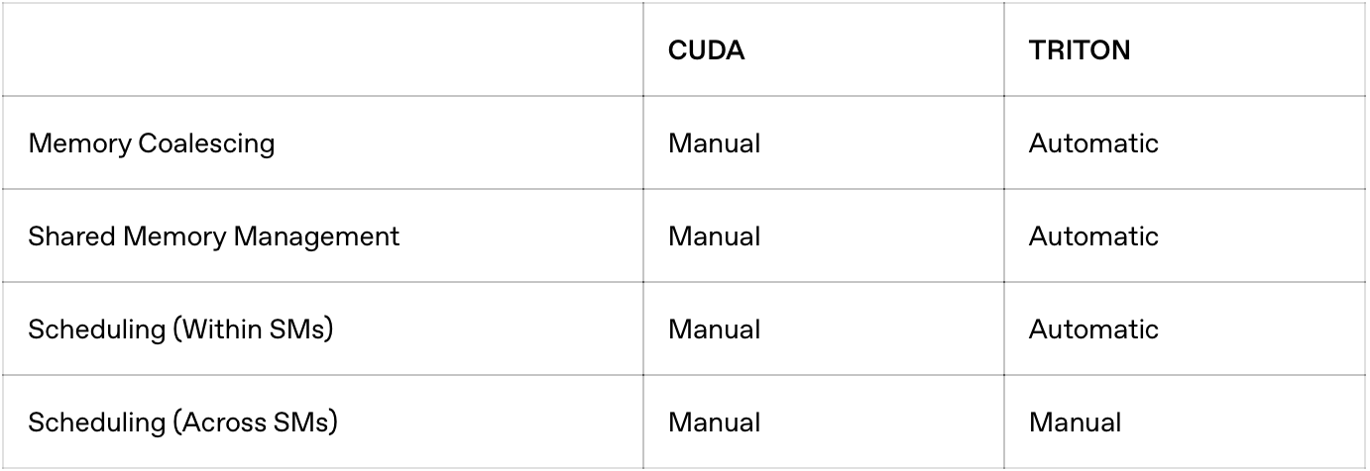
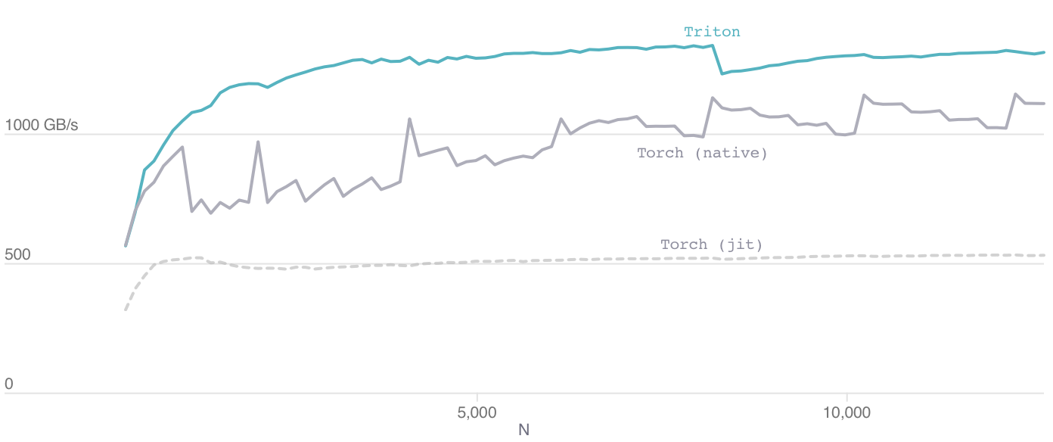
AI-DSL Design：Triton
More friendly GPU development DSL
Compiler Flow
  Dialect->Triton IR->LLVM IR->PTX
Compare with CUDA
Optimizatio effect (softmax)
@jit
def add(X, Y, Z, N):
pid = program_id(0)
idx= pid * 512 + arange(512)
mask = idx < N
x = load(X + idx, mask=mask)
y = load(Y + idx, mask=mask)
store(Z + idx, x + y, mask=mask)
visible .entry add(
.param .u64 add_param_0, .param .u64 add_param_1,
.param .u64 add_param_2, .param .u32 add_param_3
)
.maxntid 128, 1, 1
{
.reg .pred %p<4>;
.reg .b32 %r<18>;
.reg .b64 %rd<8>;
ld.param.u64 %rd4, [add_param_0];
ld.param.u64 %rd5, [add_param_1];
mov.u32 %r13, %tid.x;
ld.param.u32 %r14, [add_param_3];
shl.b32 %r15, %r13, 2;
mov.u32 %r16, %ctaid.x;
mad.lo.s32 %r17, %r16, 512, %r15;
setp.ge.s32 %p3, %r17, %r14;
setp.lt.s32 %p1, %r17, %r14;
mul.wide.s32 %rd7, %r17, 4;
add.s64 %rd2, %rd4, %rd7;
@%p1 ld.global.cg.v4.b32 {%r5,%r6,%r7,%r8}, [ %rd2 + 0];
add.s64 %rd3, %rd5, %rd7;
@%p1 ld.global.cg.v4.b32 {%r9,%r10,%r11,%r12}, [ %rd3 + 0];
@%p3 bra LBB0_2;
ld.param.u64 %rd6, [add_param_2];
add.s64 %rd1, %rd6, %rd7;
add.s32 %r1, %r5, %r9;
add.s32 %r2, %r6, %r10;
add.s32 %r3, %r7, %r11;
add.s32 %r4, %r8, %r12;
st.global.v4.u32 [%rd1], {%r1, %r2, %r3, %r4};
LBB0_2:
ret;
}
def void add(i32* X .aligned(16) , i32* Y .aligned(16) , i32* Z .aligned(16) , i32 N .multipleof(2) ) {
entry:
%0 = get_program_id[0] i32;
%1 = mul i32 %0, 512;
%3 = make_range[0 : 512] i32<512>;
%4 = splat i32<512> %1;
%6 = add i32<512> %4, %3;
%9 = splat i32<512> N;
%11 = icmp_slt i1<512> %6, %9;
%14 = splat i32*<512> X;
%16 = getelementptr i32*<512> %14, %6;
%19 = broadcast i1<512> %11;
%21 = splat i32<512> undef;
%22 = masked_load i32<512> %16, %19, %21;
%26 = splat i32*<512> Y;
%28 = getelementptr i32*<512> %26, %6;
%31 = broadcast i1<512> %11;
%33 = splat i32<512> undef;
%34 = masked_load i32<512> %28, %31, %33;
%38 = splat i32*<512> Z;
%40 = getelementptr i32*<512> %38, %6;
%43 = add i32<512> %22, %34;
%46 = broadcast i32<512> %43;
%48 = broadcast i1<512> %11;
masked_store void %40, %46, %48;
ret void;}

Slide 18
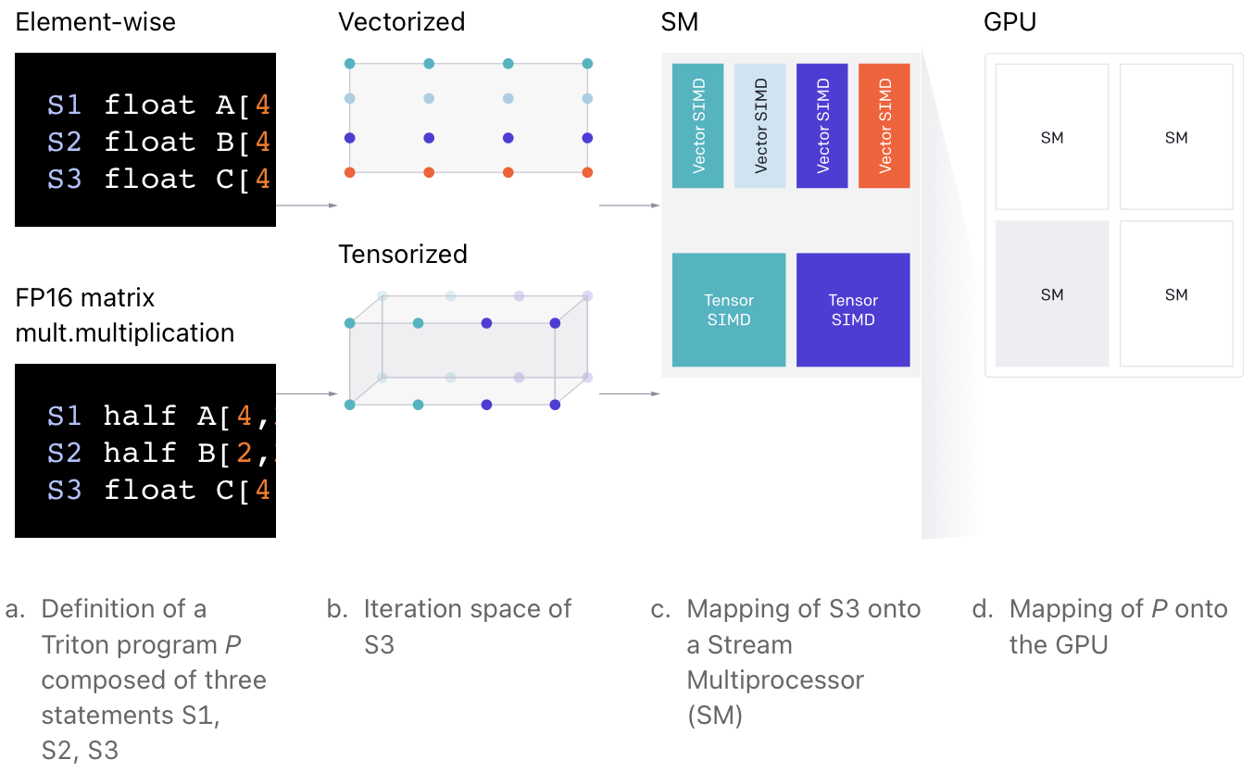
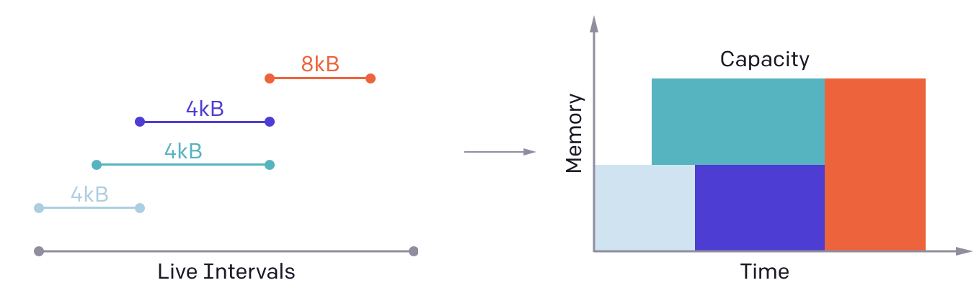
AI-DSL Design：Triton
Expose block-parallelism
  Each kernel instance carry on block operation in parallel
Allocate shared memory based on varaible living analysis
automatically parallelize opeartions both by instance and by SMs
  Analyze the iteration space of each operation then partition
BLOCK = 512
# This is a GPU kernel in Triton.
# Different instances of this
# function may run in parallel.
@jit
def add(X, Y, Z, N):
pid = program_id(0)
# block of indices
idx = pid * BLOCK + arange(BLOCK)
mask = idx < N
...
# Triton uses pointer arithmetics # rather than indexing operators x = load(X + idx, mask=mask) y = load(Y + idx, mask=mask) store(Z + idx, x + y, mask=mask)
...
grid = (ceil_div(N, BLOCK),)
# no thread-block
add[grid](x, y, z, x.shape[0])
S1 float A[4,4] = ...
S2 float B[4,4] = ...
S3 float C[4,4] = A + B
S1 half A[4,2] = ...
S2 half B[2,2] = ...
S3 float C[4,2] = dot(A,B)

Slide 19
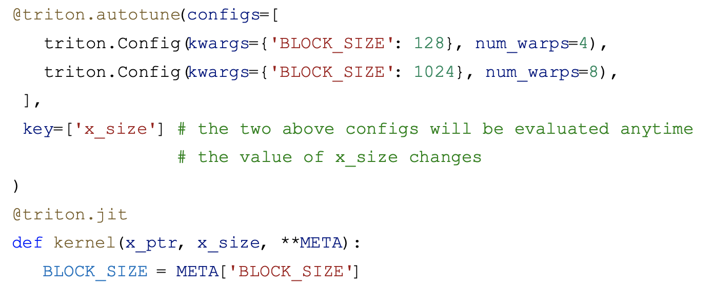
AI-DSL Design：Triton
Autotuning
  Consider tile sizes
  Explore at compilation
Optimization passes
  Computation graph patttern substitution
  Dead code elimination
  ...
Use MLIR to lower layer by layer
Most passes reuse MLIR
  Arith: addf, addi, constant, cmpf, cmpi, ...
  Math: exp, sin, cos, log, absi, absf, sqrt
  StructuredControlFlow: for, if, while, yield, condition
  Reduce cost lowering to LLVM
LLVM emits final GPU code

Slide 20
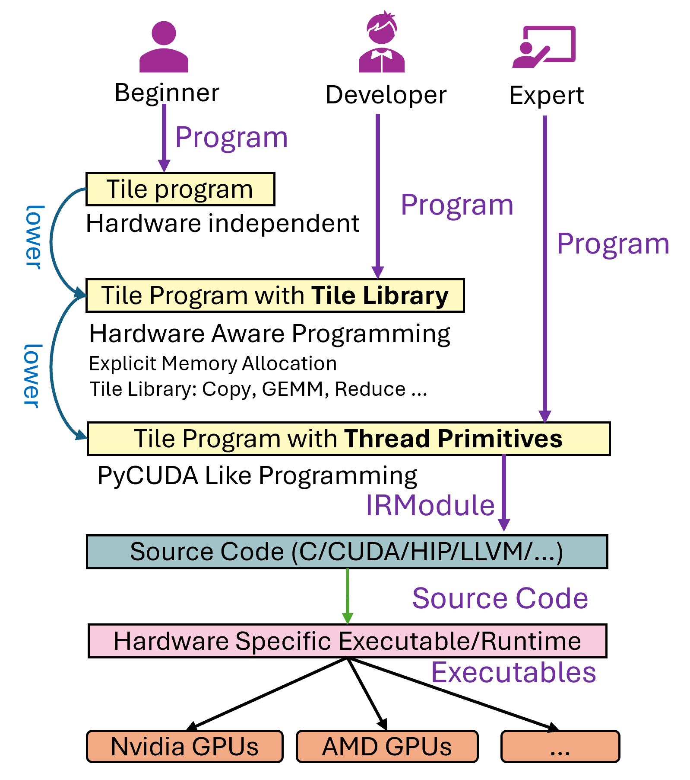
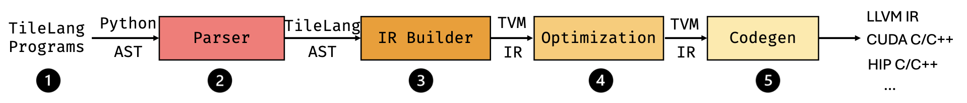
AI-DSL Design: TileLang
Provide three different programming interfaces
  Beginner Level: Hardware-Unaware
  Developer Level: Hardware-Aware with Tile Library
  Expert Level: Hardware-Aware with Thread Primitives
Compilation Flow
  Tile Program: A high-level specification of the computation
  Tile Program with Tile Library
  Tile Program with Thread Primitives
  IRModule
  Source Code Generation (C/CUDA/HIP/LLVM/…)
Notes:
TileLang enables developers to write kernels at a high level of abstraction

Slide 21
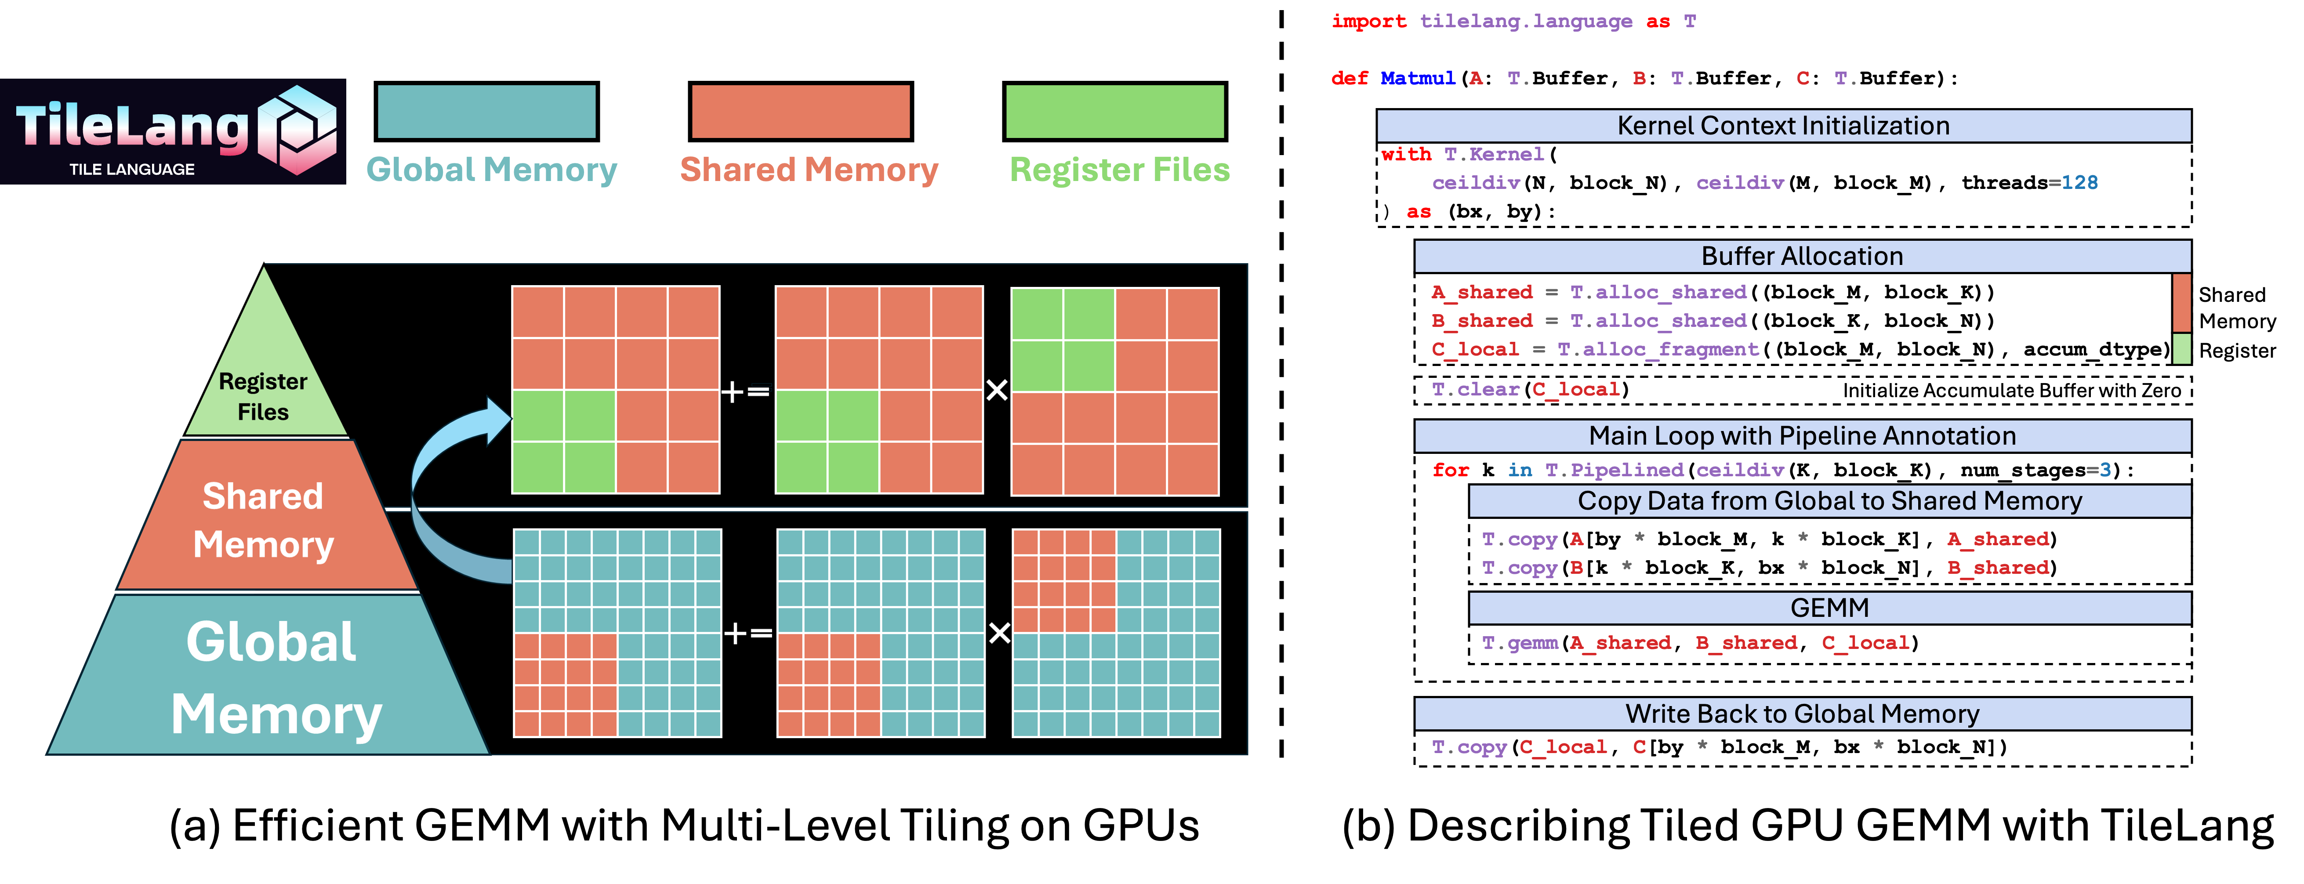
AI-DSL Design: TileLang
Tile declarations: Tiles as First-Class Objects
  A tile represents a shaped portion of data
    Can be owned and manipulated by a warp, thread block, or equivalent parallel unit
    A and B buffers are read in tiled chunks (in example below)
  Execution context: thread block index (bx and by) and the number of threads
    Make it easier for the TileLang to automatically optimize

Slide 22
AI-DSL: TileLang
Explicit Hardware Memory Allocation:
  Exposes user-facing intrinsics for tile buffers placement in the hardware memory hierarchy
  Allocates memory in on-chip storage space
    T.alloc_shared
    Corresponds to shared memory on NVIDIA GPUs
  Allocates accumulators in fragment memory
    T.alloc_fragment
    corresponds to register files on NVIDIA GPUs
Explicit Hardware Memory Allocation:
  T.clear: Initialize hardware-specific buffers
  T.fill: Almost same as T.clear
  T.copy: Data transfer between global memory and hardware-specific memory
  T.Parallel: operations can also be performed in parallel for data assignments

Slide 23
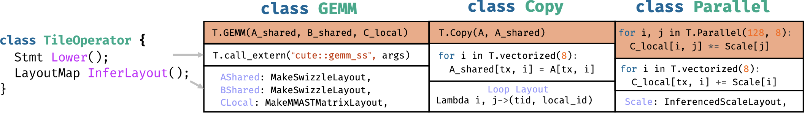
AI-DSL: TileLang
Abstracts a Set of Tile Operators for Users to Use or Define
Each Tile Operator is required to implement two key interfaces
  Lower: Defines how the high-level Tile Operator is lowered into a lower-level IR
  InferLayout: Determine the memory and loop layouts associated with the Tile Operator
Several Pre-defined Operators
  gemm: highly optimized implementation for general matrix multiplication
  reduce: flexible and efficient reduction mechanism for aggregating data across dimensions
  atomic: atomic operations for safe updates to shared or global memory in a parallel context

Slide 24
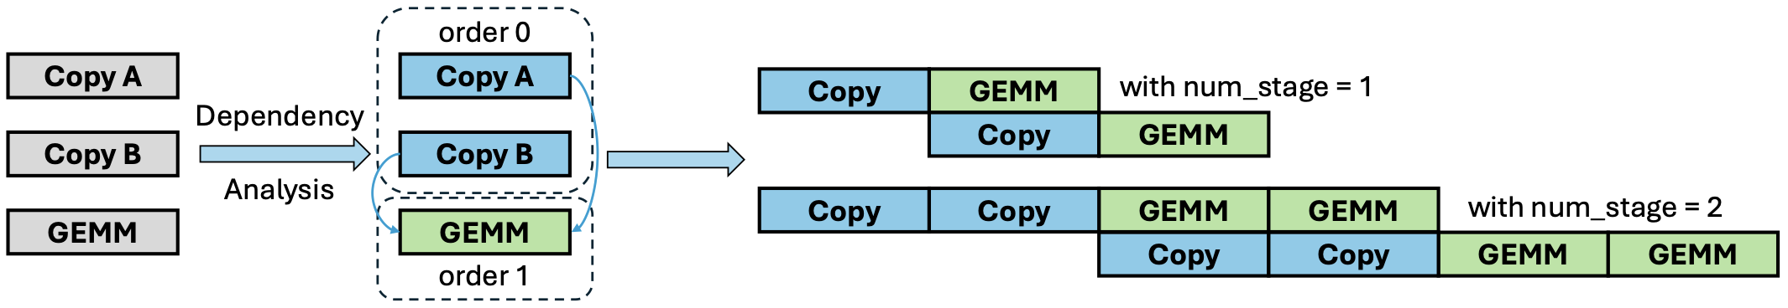
TileLang: Schedule Annotations and Primitives
TileLang provides a comprehensive suite of scheduling primitives
T.Pipelined: allows efficient pipelined execution of loops to improve performance
  Overlapping computation and memory operations
T.Parallel: automatic parallelization of loops by mapping iterations to threads
T.annotate_layout: specify memory layout optimizations for shared or global memory
T.use_swizzle: Improves L2 cache locality by enabling swizzled memory accesses

Slide 25
General Flow
AI-DSL Design
Optimization Passes

Slide 26
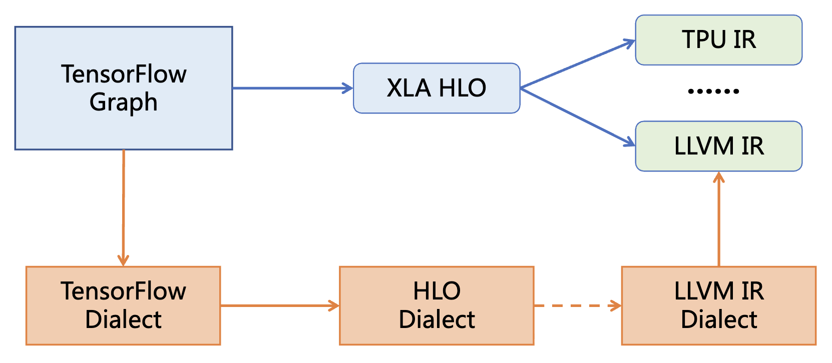
Optimization Passes: MLIR Architecture
MLIR A reusable, extensible open-source compilation infrastructure framework
  Addressing software fragmentation
  Support for compilation targeting heterogeneous hardware
  Reducing overhead for domain-specific compiler development
  Connecting existing various compilers
MLIRWhy Can Solve the Problem
  Unified syntax, reusable components
  Shared ecosystem, coordinated optimization across levels
  Small gaps between levels, easy to implement

Slide 27
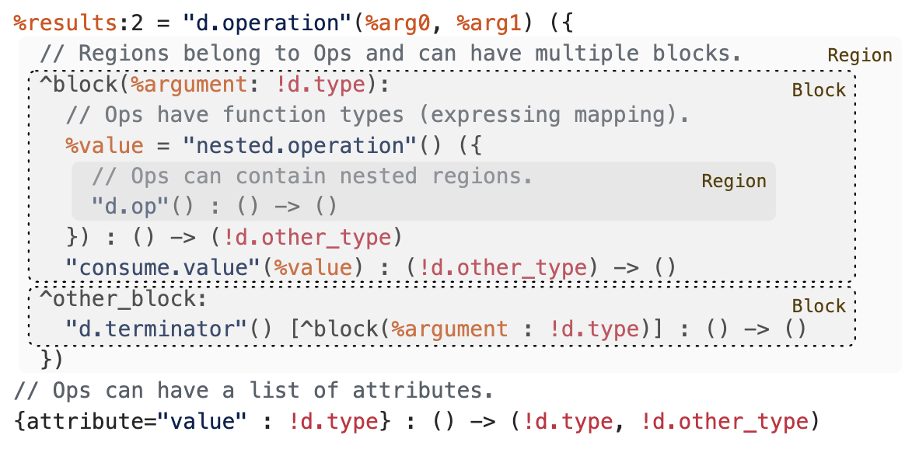
Optimization Passes: MLIR Components
Module:
  Top-level container encapsulating the entire compilation unit, isolating external variable scopes .
Region:
  Breaking through flat CFG limitations, preserving loops as“first-class citizens” in nested structures.
Block:
  IntroducingBlock Arguments avoiding traditional LLVM high-maintenance PHI nodes
Operation and Attribute:
  Highly unified opaque API, along with globally uniqued attribute dictionaries for representing constants.

Slide 28
Optimization Passes: TTIR
Triton lowering process
  Python Triton Kernel
  Triton Frontend (AST + JIT specialization)
  TTIR (Triton MLIR Dialect)
  TTGIR (Triton GPU Dialect)
  LLVM IR (NVVM Dialect)
  PTX
  SASS
Tensor-Level optimization passes (TTIR)
Canonicalization: simplifies IR by
  constant folding
  algebraic simplification
  dead operation removal
  redundant cast elimination
Layout Propagation
  blocked layouts
  shared layouts
  sliced layouts

Slide 29
Optimization Passes: TTGIR
GPU Mapping Passes
  Lowering Tensor Programs onto GPU Execution Model
TTGIR introduces GPU hardware concepts absent from TTIR
Thread Mapping
  Maps tensor tiles onto, programs, warps, lanes
Shared Memory Promotion
  Frequently reused tensors
  Global memory->shared memory
Software Pipelining
  overlap memory latency
  controlled by num_stages
  Reschedule can help enhance efficiency
Block Tiling
  MxN matrix -> BLOCK_M × BLOCK_N tiles
  Specified/autotuned by python triton kernel
Load(k+1)
Compute(k)
Store(k−1)

Slide 30
Optimization Passes: TTGIR
Warp-level optimization
  warp shuffle
  warp reduction
  warp synchronization
Memory coalescing
  Transforms scattered accesses into contiguous memory transactions
Vectorization
  improving memory bandwidth
  load f32->load.v4.f32
Tensor core pattern recognition
  Detects matrix multiply patterns
  lower to mma.sync
Thread
0 -> A0
1 -> A64
2 -> A3
Thread
0 -> A0
1 -> A1
2 -> A2

Slide 31
Optimization Passes: LLVM
LLVM no longer sees tensors
  SSA values
  basic blocks
  scalar instructions
mem2reg
  Promotes stack variables into registers
Instruction Combining
  (a+b)+c -> a+(b+c)
  mul(x,2) -> shift
Global Value Numbering
  Eliminates redundant computations across control flow
Loop-Invariant code motion
  Moves invariant computations outside loops
Register allocation
  Assigns virtual registers to physical GPU registers
LLVM performs classical compiler optimizations independent of machine learning

Slide 32
Optimization Passes: Parameter and Effect
Relating kernel parameters to compiler decisions
Parameter | Compiler Pass | Effect
BLOCK_M/N/K | Tile Formation | Tile size
num_warps | Thread Mapping | Warp decomposition
num_stages | Software Pipelining | Latency hiding
Grid | Program Scheduling | CTA generation
dtype | Instruction Selection | Tensor Core eligibility

